Slide 1
NFL Fantasy Draft Analysis
Sang Lee
DSI

Slide 2
Problem Statement
Fantasy sports is an online game of where participants assemble imaginary or virtual teams of real players of a professional sport.
It is very common for these participants to pick or draft players by instincts rather than making a pure data driven decisions.
This practice can work out sometimes, but the results are not consistent. Participants often make rash decisions since there is no basis in the decision making.
Therefore, I will leverage data to make a predictive model that will give draft recommendations.

Slide 3
Goals
Come up with a predictive model that will produce a better recommendation than the experts from FantasyPros.com
The results will be evaluated by the coefficient of determination or the R^2 value. This value is a number that indicates the proportion of the variance in the dependent variable that is predictable from the independent variable

Slide 4
Process

Slide 5
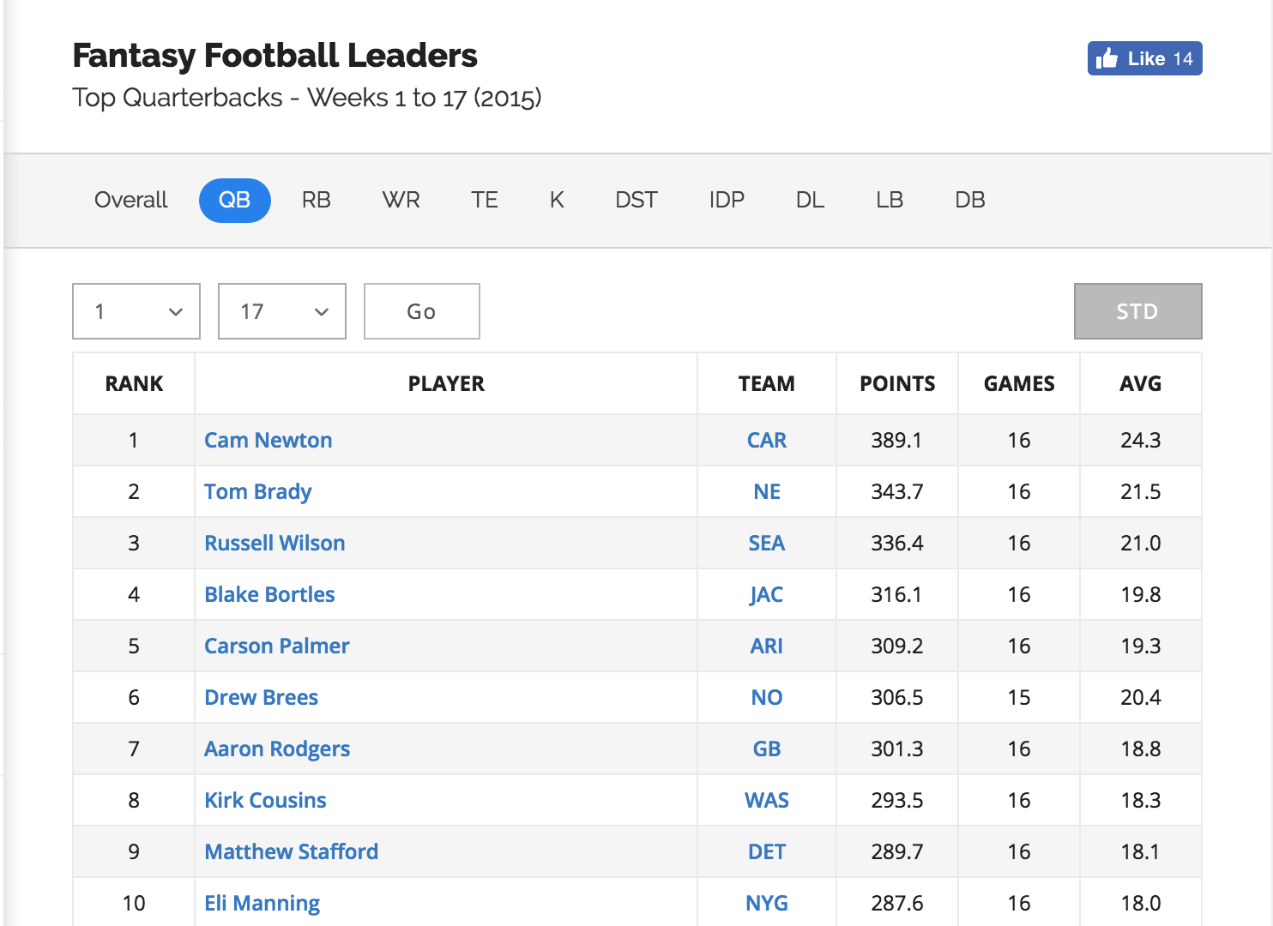
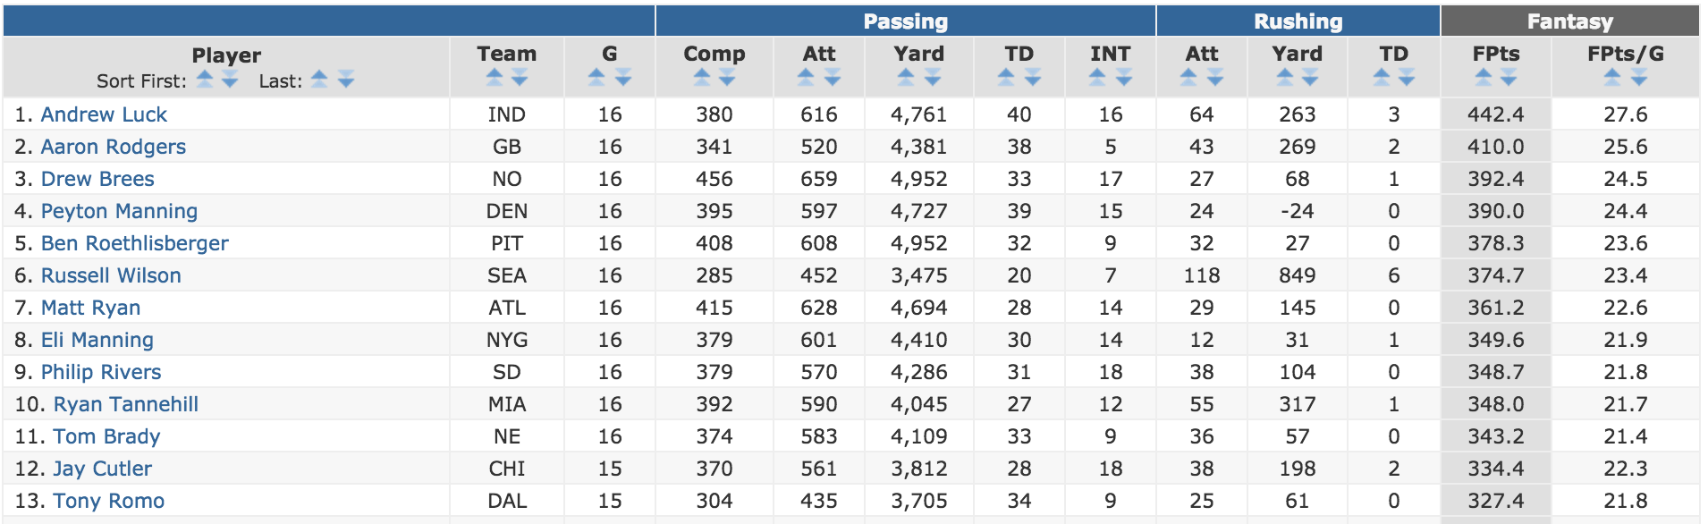
Data
FantasyPros.com
FFtoday.com

Slide 6

Notes:
LiveSlide Site
https://10az.online.tableau.com/t/sanglee1214/views/FantasyFootball2016/ActualvsProjected?:embed=y&:showShareOptions=true&:display_count=no&:showVizHome=no

Slide 7
Notes:
LiveSlide Site
https://10az.online.tableau.com/t/sanglee1214/views/FantasyFootball2016/Dashboard1?:embed=y&:showShareOptions=true&:display_count=no&:showVizHome=no

Slide 8
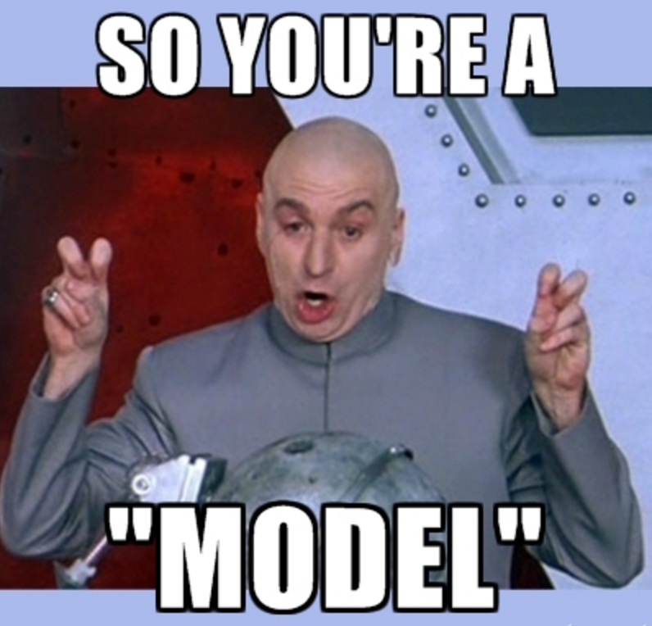
Models
Standard linear regression/Lasso regression
Optimized Decision Tree Regression
Random Forest Regression

Slide 9
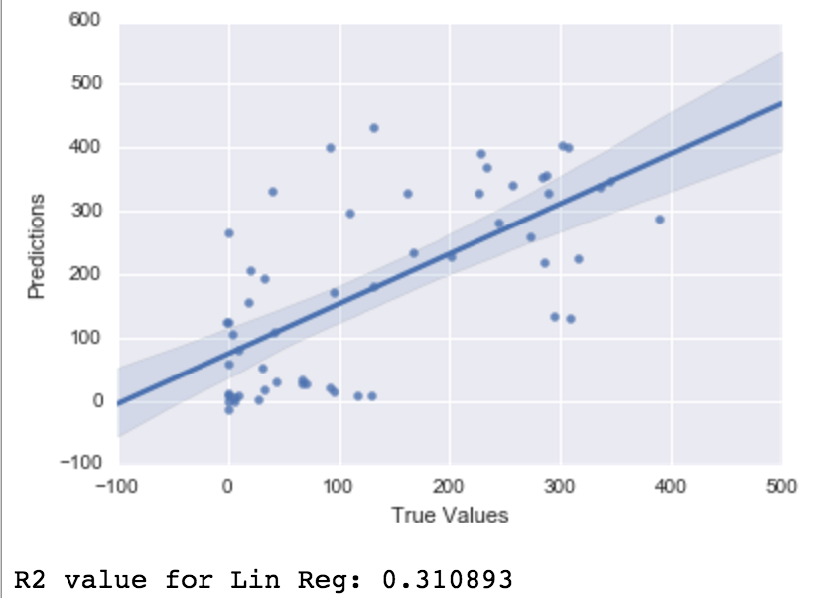
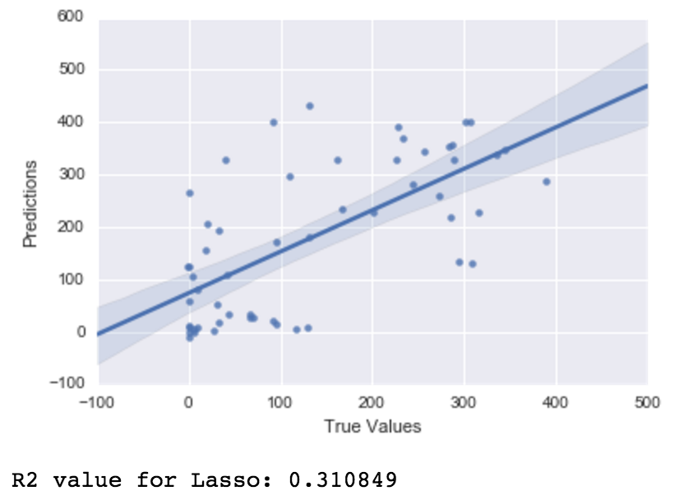
Standard Linear/Lasso for QB

Slide 10
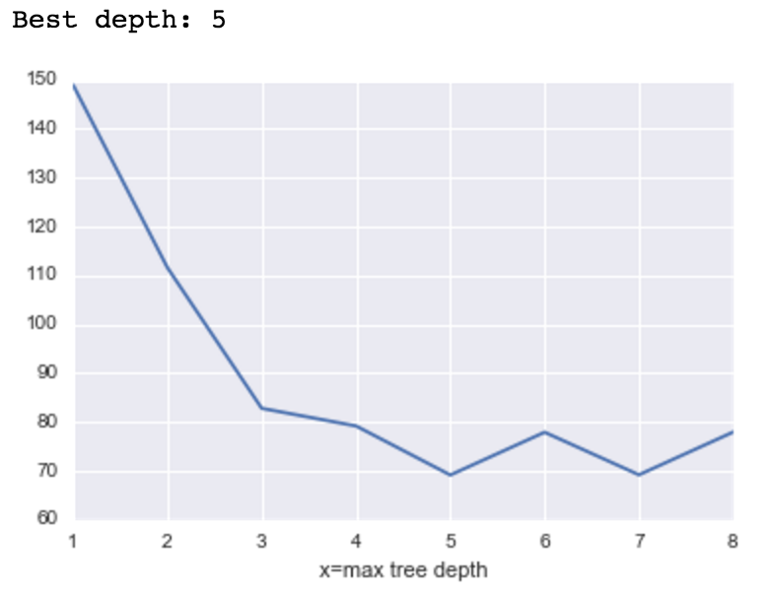
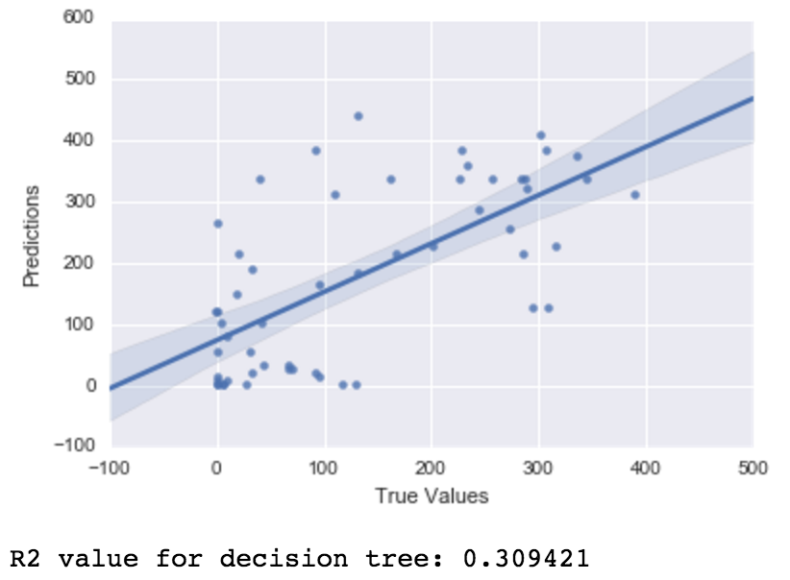
Decision Tree Regression For QB

Slide 11
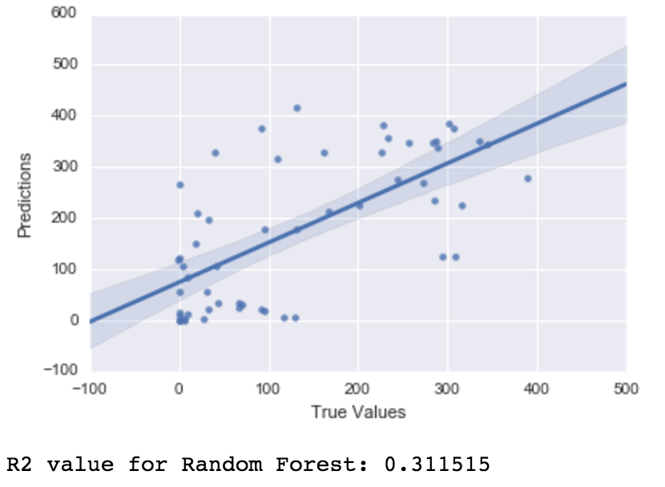
Random Forest Regression For QB

Slide 12
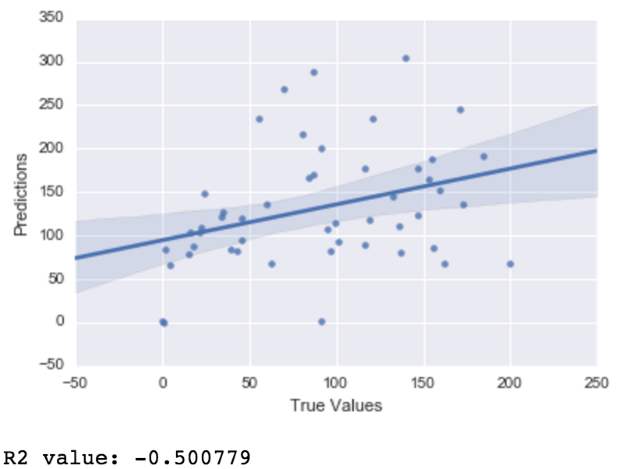
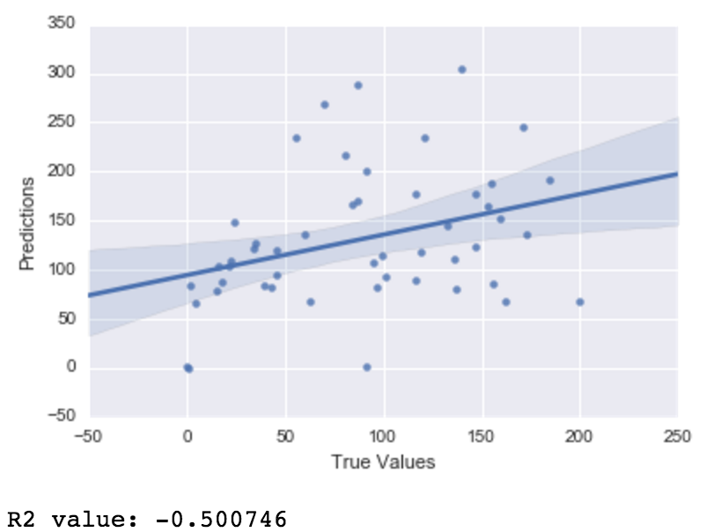
Standard Linear/Lasso for RB

Slide 13
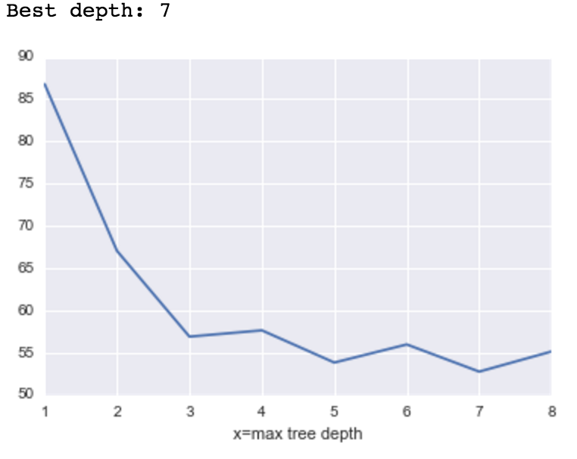
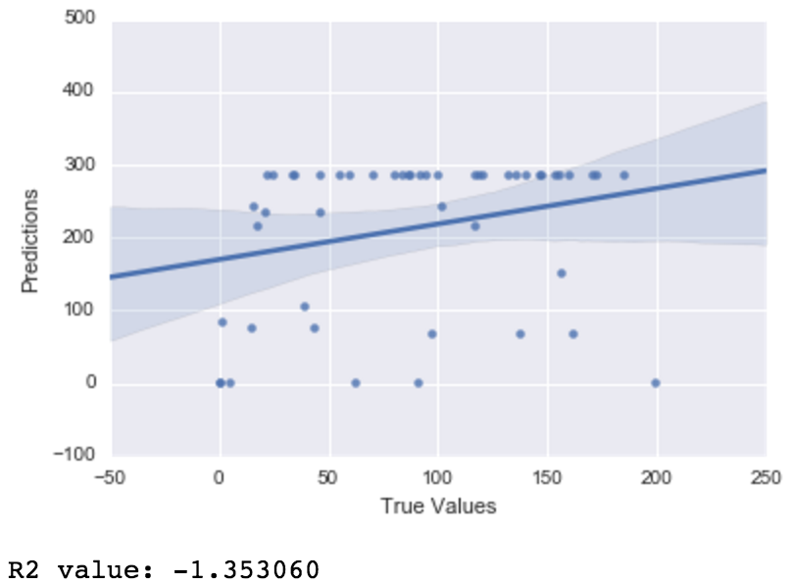
Decision Tree Regression for RB

Slide 14

Random Forest Regression for RB

Slide 15

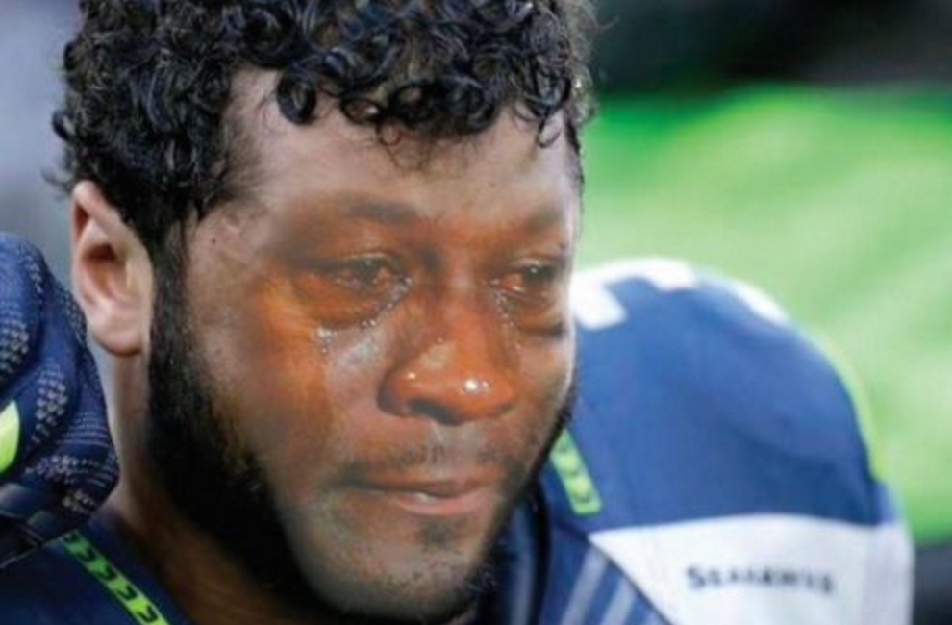
Failed?!

Slide 16
Future Models
Cannot determine based on purely last year’s stats
Need to have different features such as team ranking, likelihood of injuries, and more
Requires more research on how the experts came up with these numbers

Slide 17
Next Steps
Use clustering algorithms on the expert’s predictions to group the players that weigh the same in terms of final fantasy points

Slide 18
Clustering Algorithms
DBSCAN (Density-based spatial clustering of applications with noise)
K-means
Gaussian Mixture Model

Slide 19
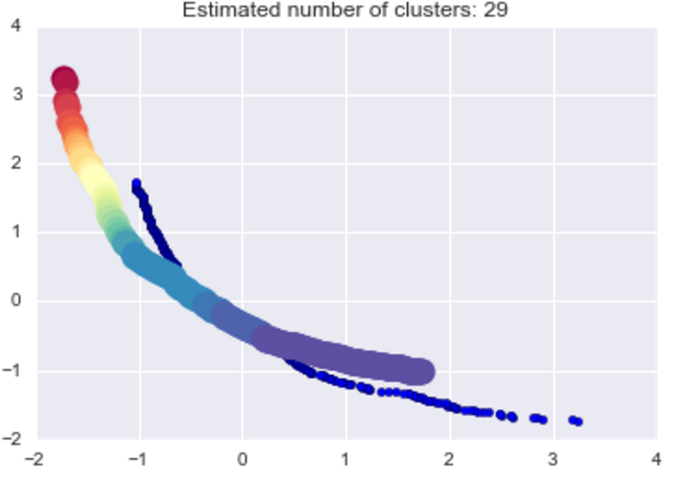
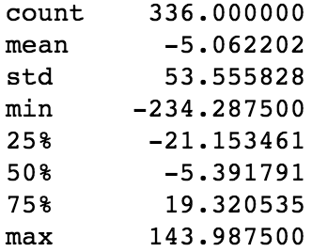
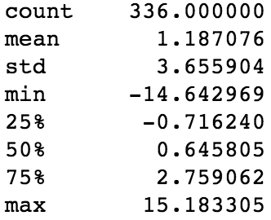
DBSCAN
Total Difference
Total Difference Per Game

Slide 20
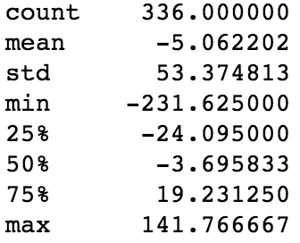
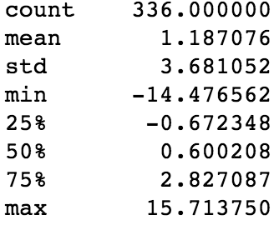
K-means
Total Difference
Total Difference Per Game

Slide 21
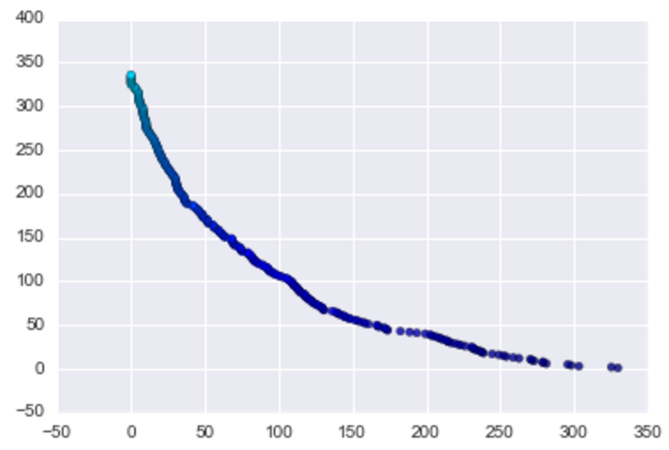
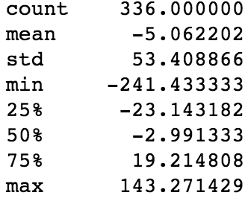
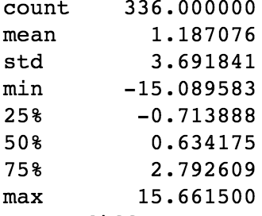
Gaussian Mixture Model
Total Difference
Total Difference Per Game

Slide 22
Recommendation

Slide 23
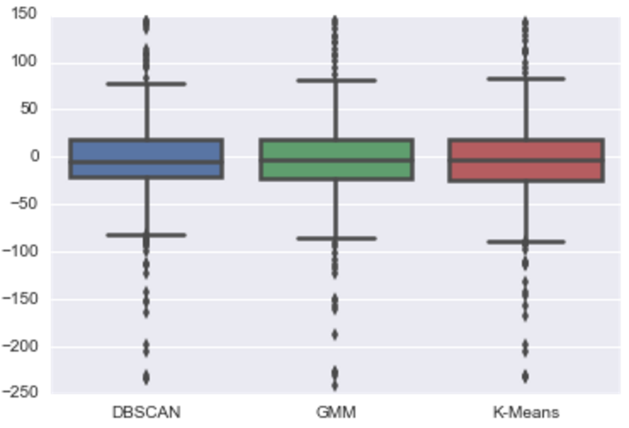
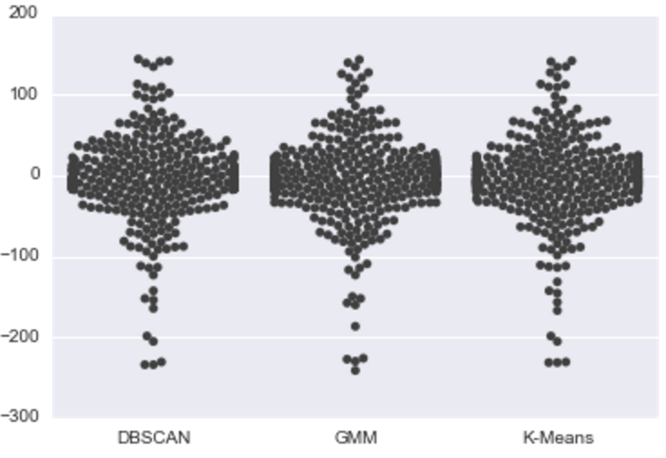
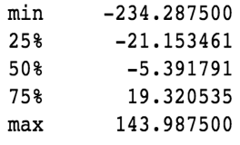
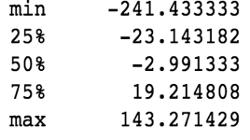
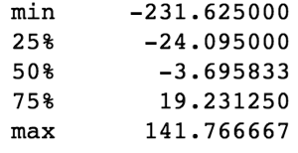
Comparison for Total difference
DBSCAN
GMM
K-Means

Slide 24
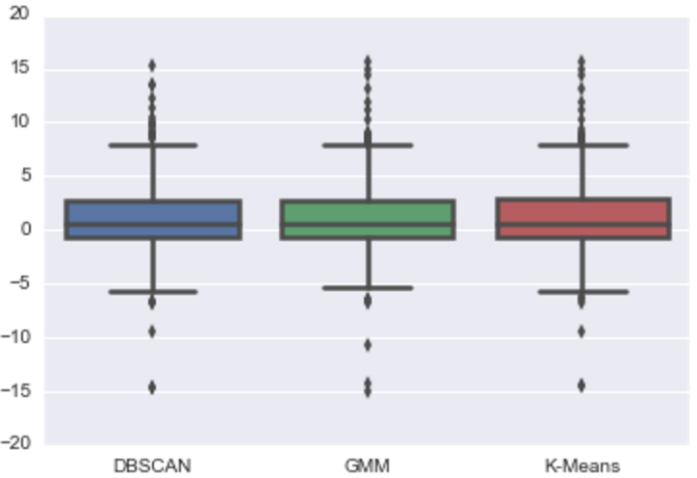
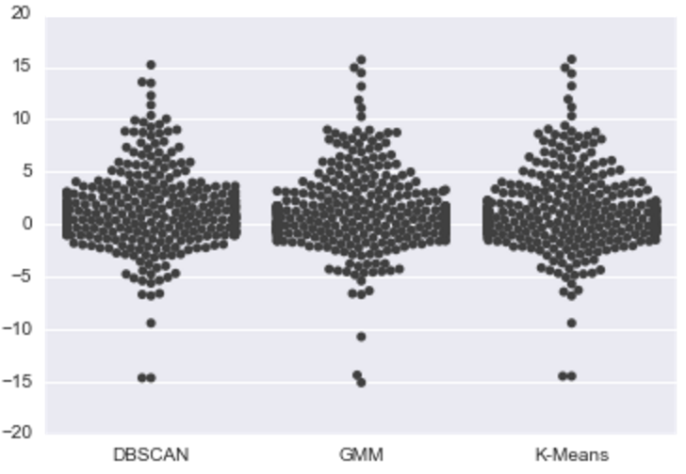
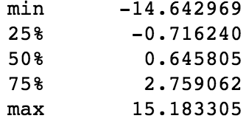
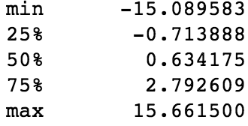
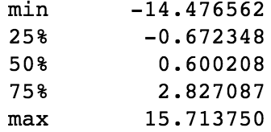
Comparison for Total difference Per Game
DBSCAN
GMM
K-Means

